Slide 1
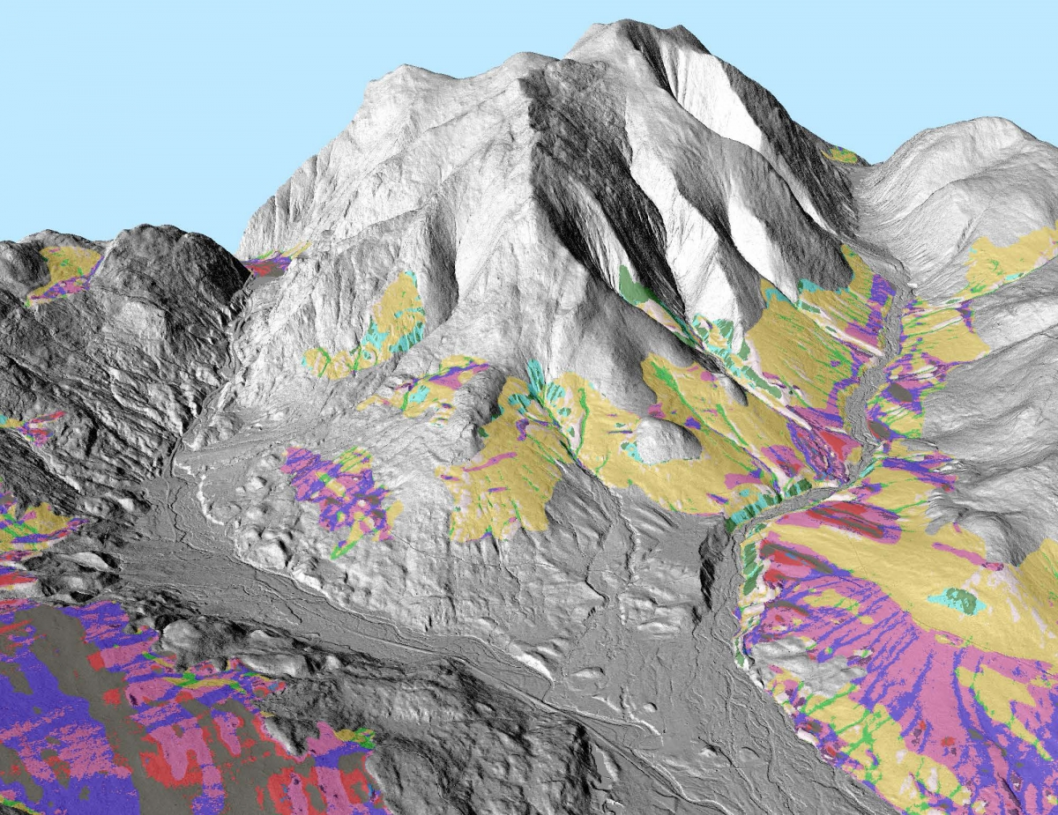

The Application of LiDAR to Watershed Management on the White Mountain National Forest
Landon Gryczkowski
Hydrologist, White Mountain National Forest

Slide 2
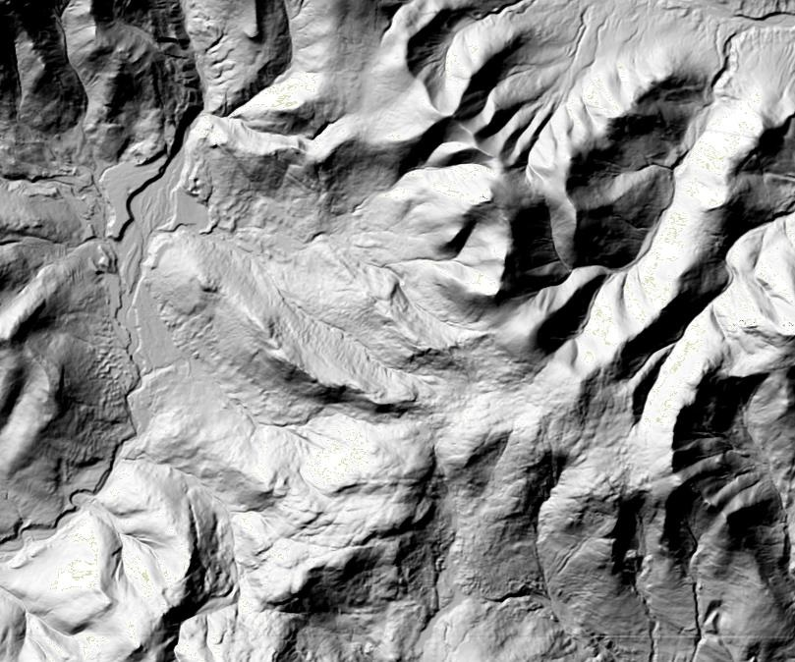
Overview
What is LiDAR and why is it so cool?
LiDAR status in NH
Current applications
Planned, near-future applications
Future applications

Slide 3
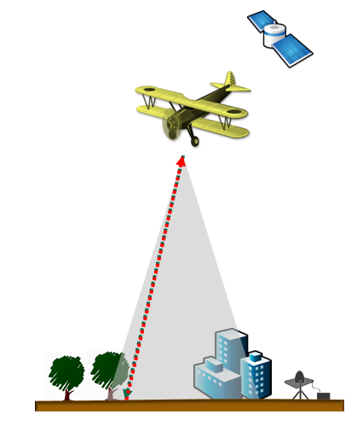
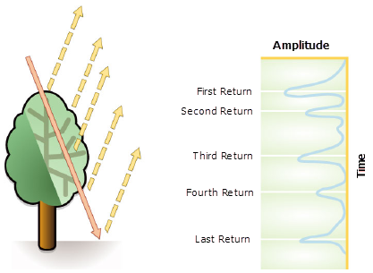
What is LiDAR?
Light Detection and Ranging
Optical remote sensing technique using lasers
Produces mass point cloud datasets
http://desktop.arcgis.com/en/arcmap/10.3/manage-data/las-dataset/what-is-lidar-data-.htm

Slide 4
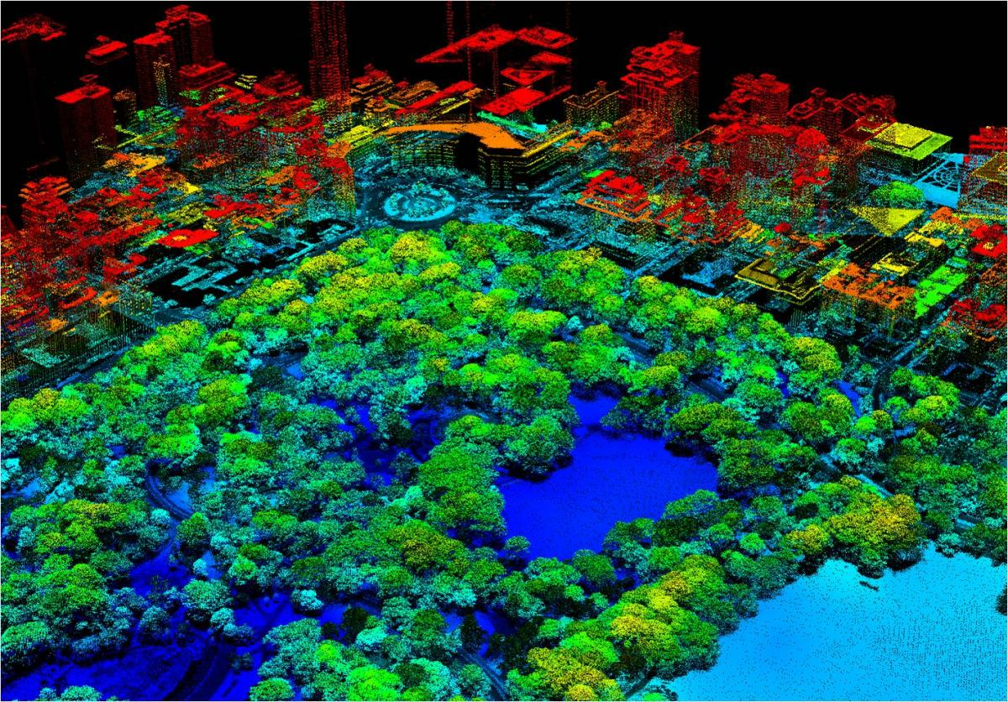
Why is LiDAR so cool?
Map top of tree canopy
Map ground surface elevation
Actual measurements of ground surface
High resolution
Repeated measurements
NYC point cloud. Credit: Jarlath O'Neil-Dunne; UVM-SAL

Slide 5
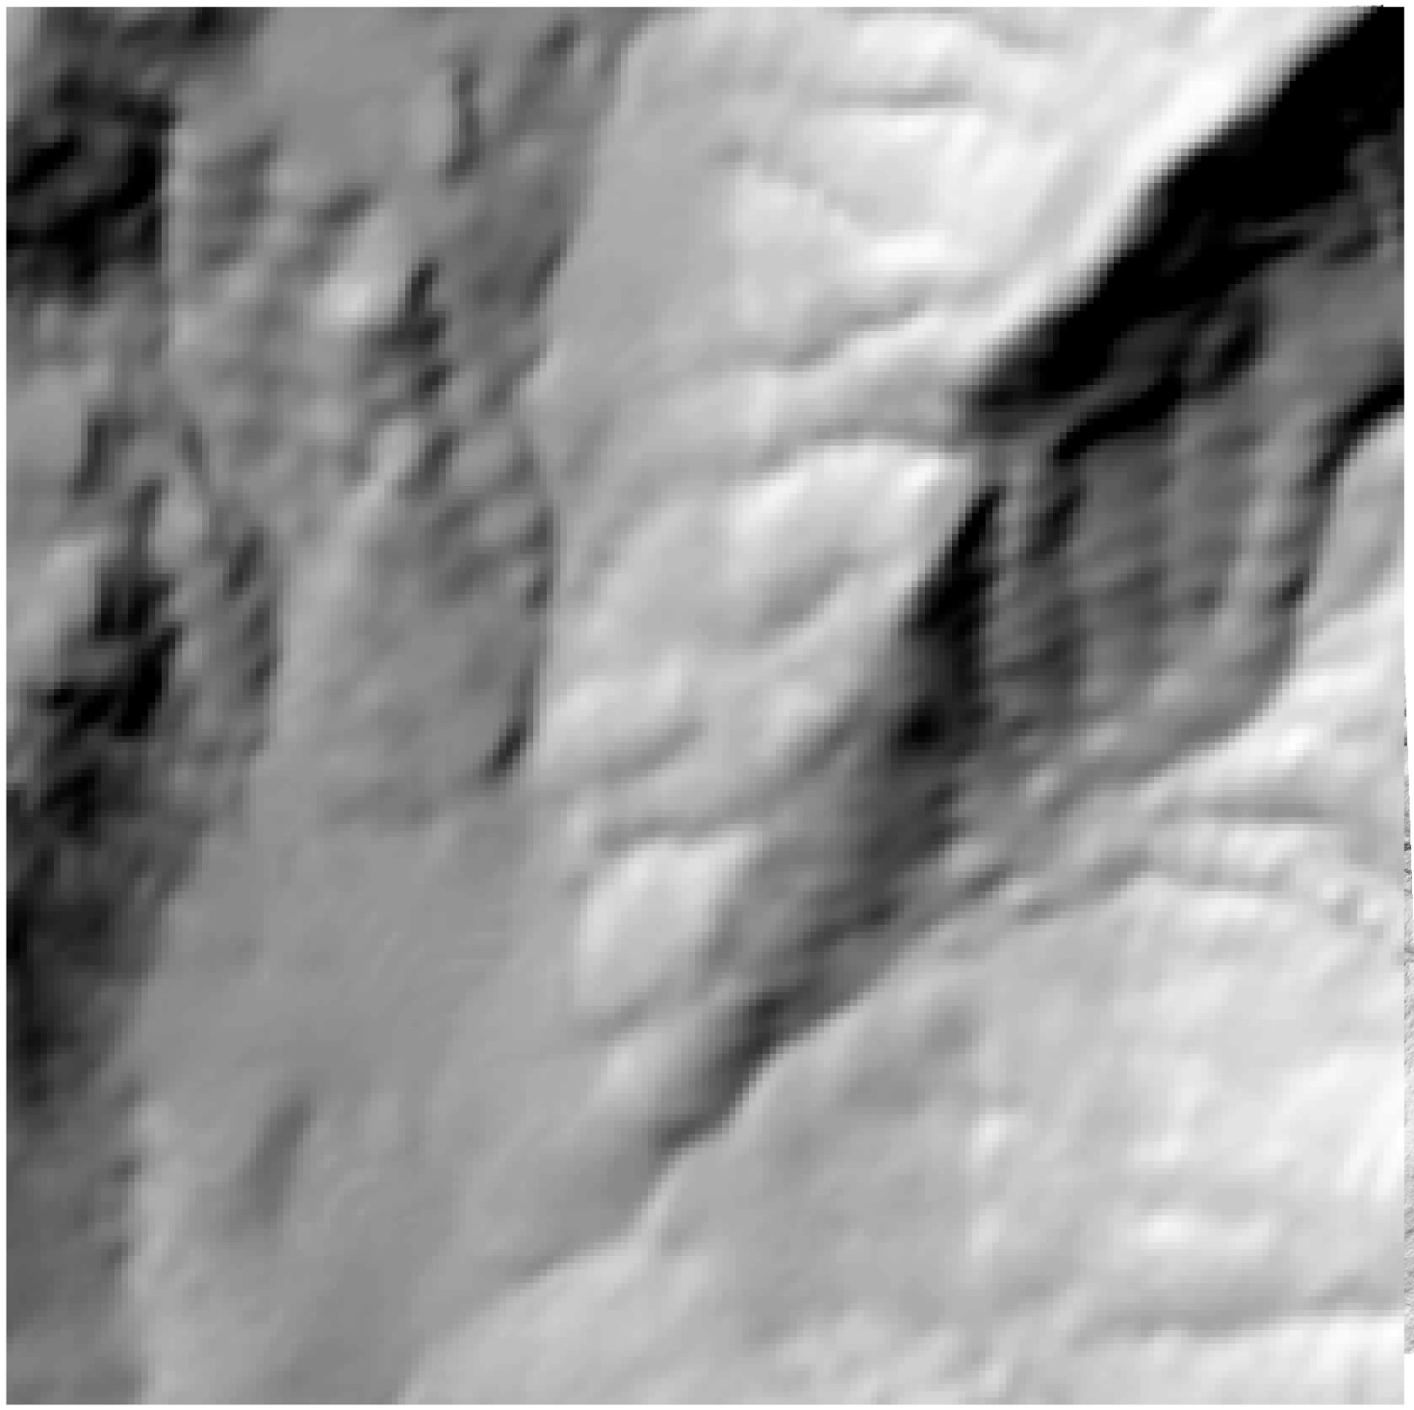
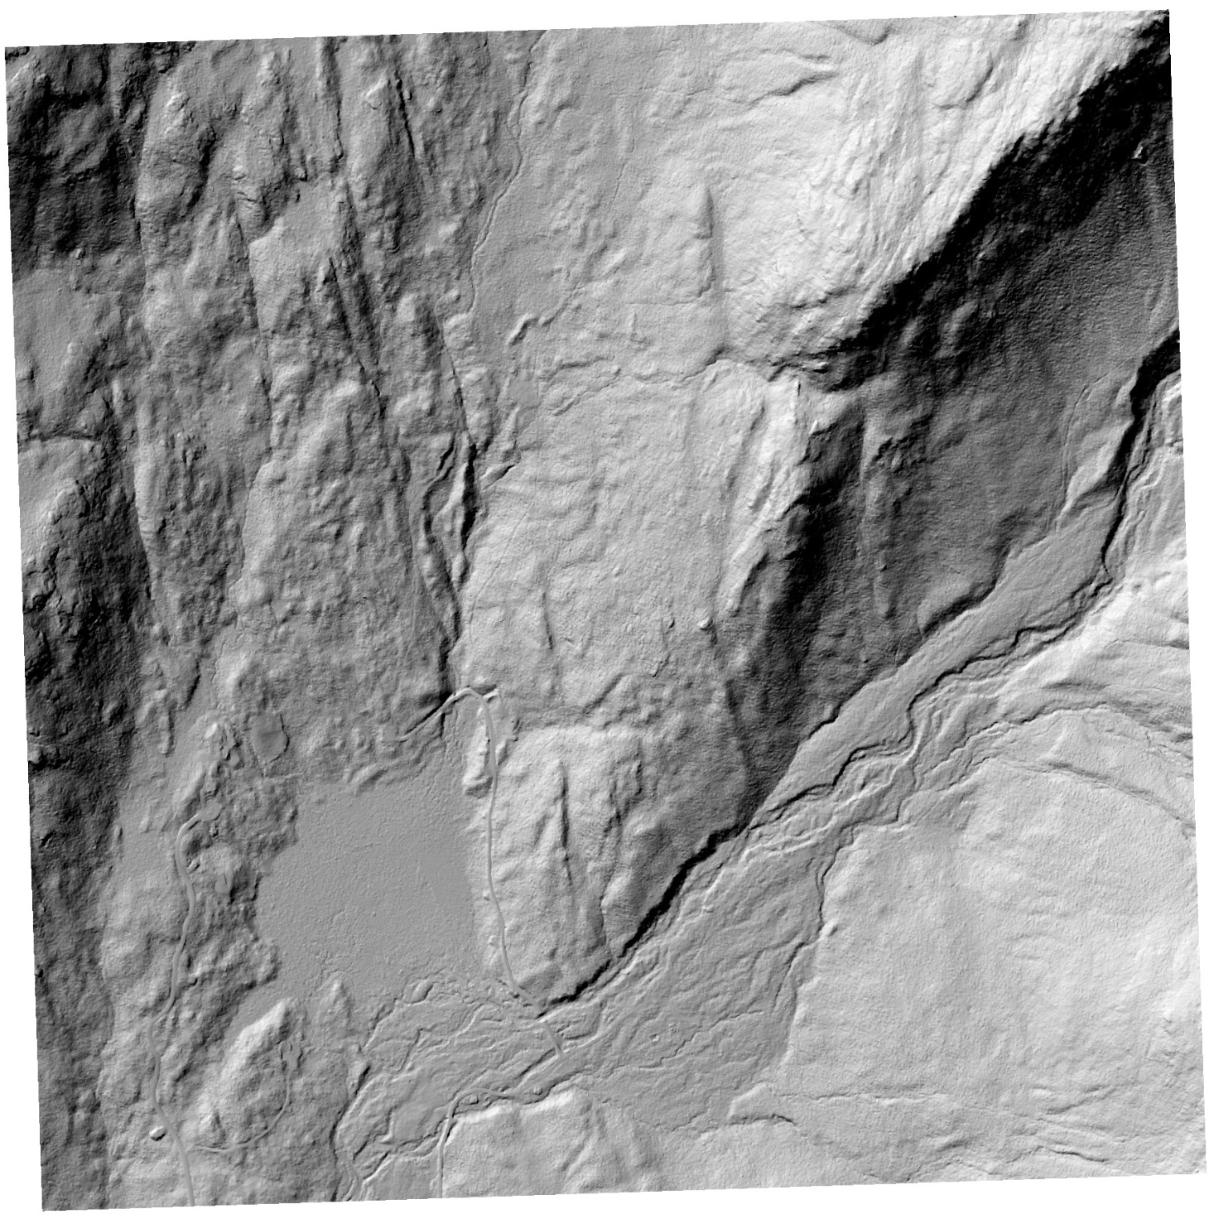

Slide 6
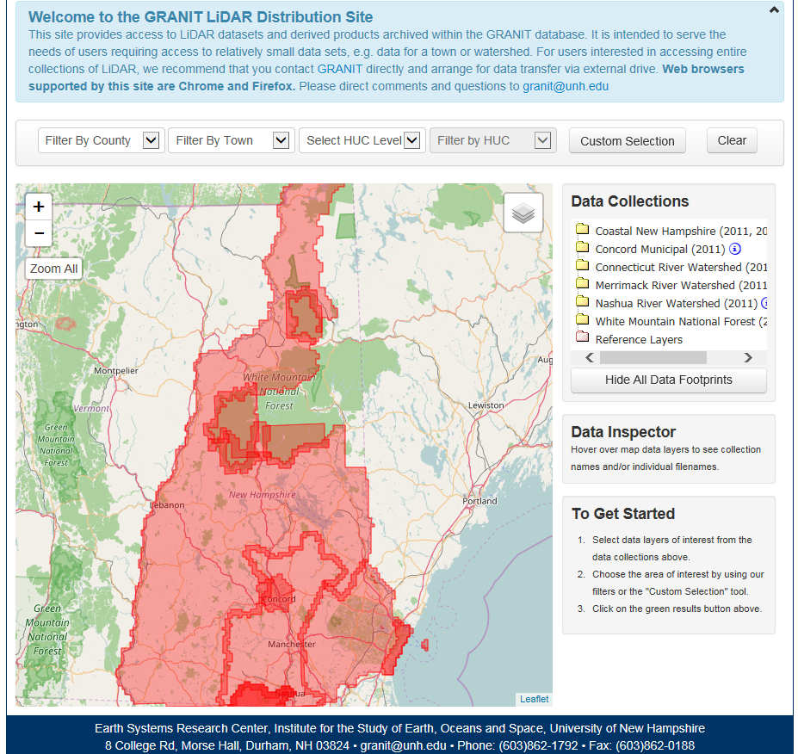
LiDAR Status in NH
http://lidar.unh.edu/map/

Slide 7
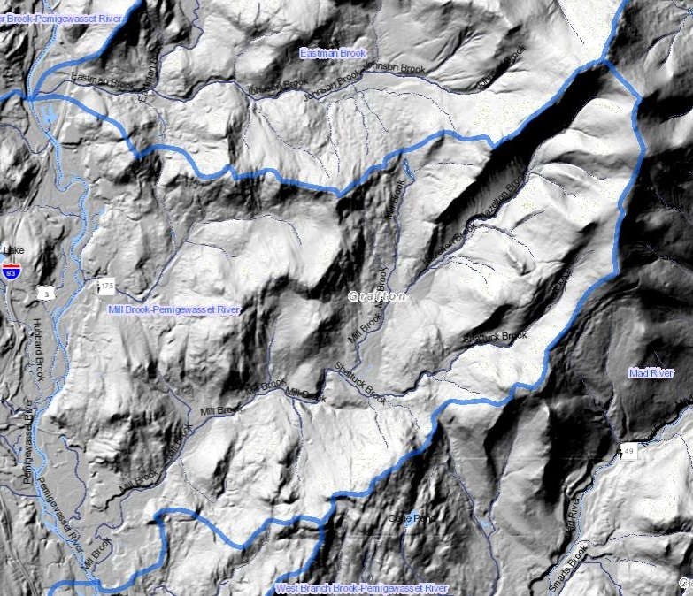
Current Applications
Updating the Watershed Boundary Dataset (WBD)

Slide 8
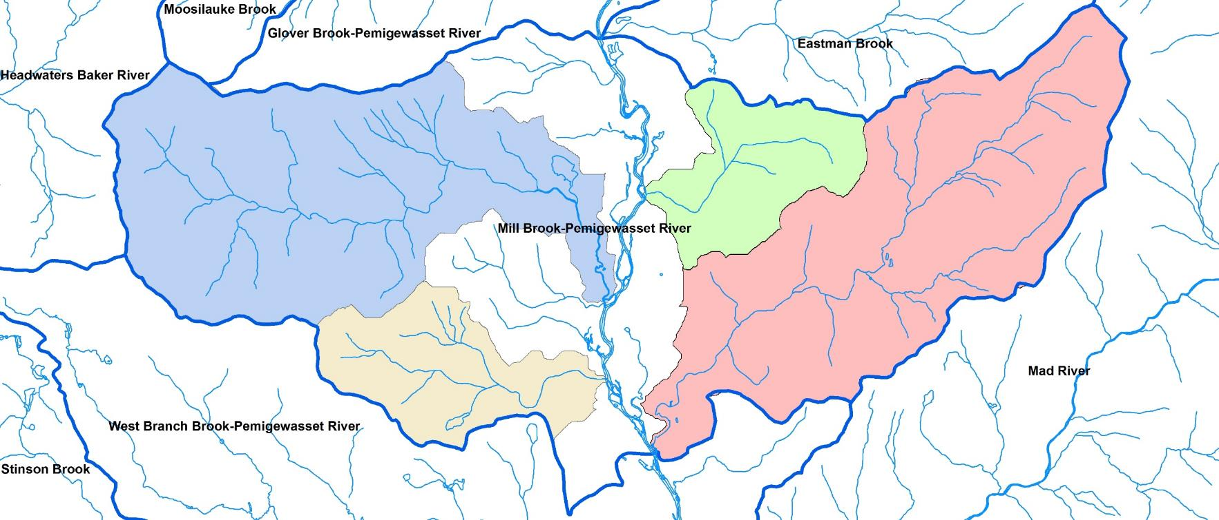
Current Applications
Delineating HUC-14 and HUC-16 watersheds

Slide 9
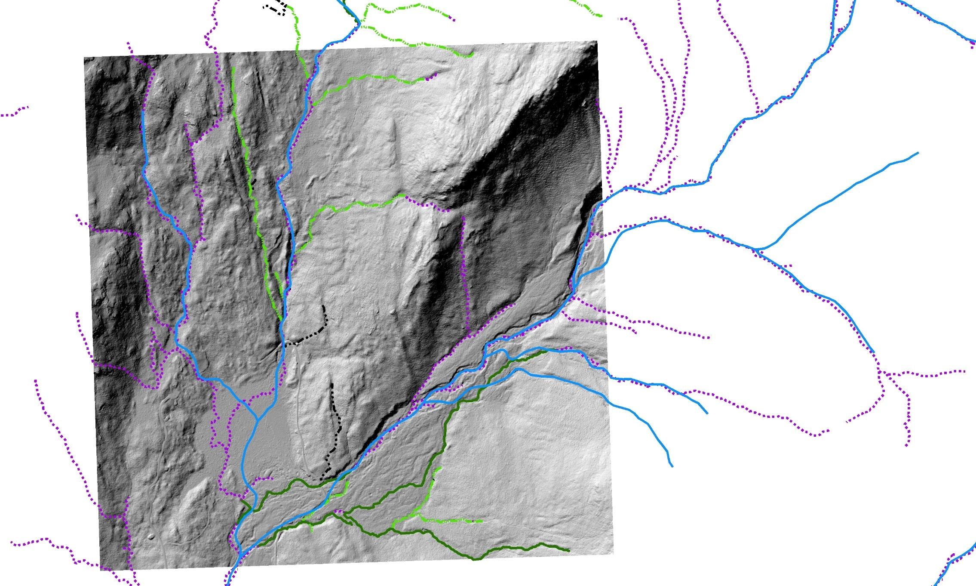
Current Applications
Updating the National Hydrography Dataset (NHD) flowlines

Slide 10
Current Applications
Forest-wide soil mapping and Terrestrial Ecological Unit (TEU) mapping

Slide 11
Planned Applications
Mapping potential vernal pools
Photos: UNH Cooperative Extension

Slide 12
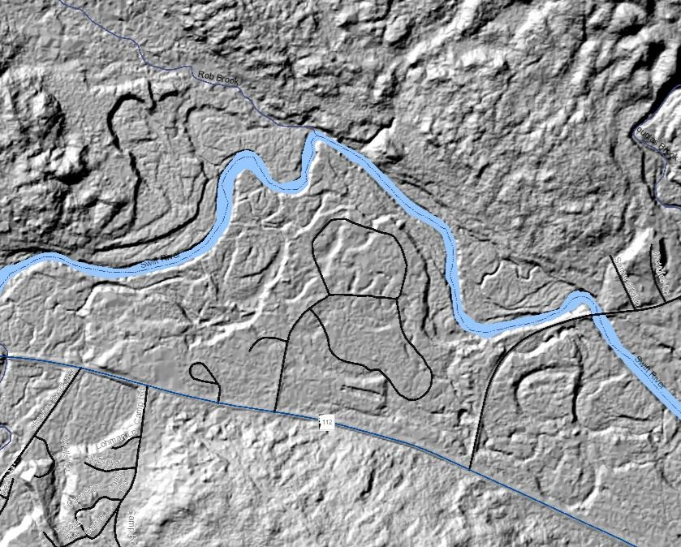
Planned Applications
Flood hazard analysis at campgrounds near rivers

Slide 13
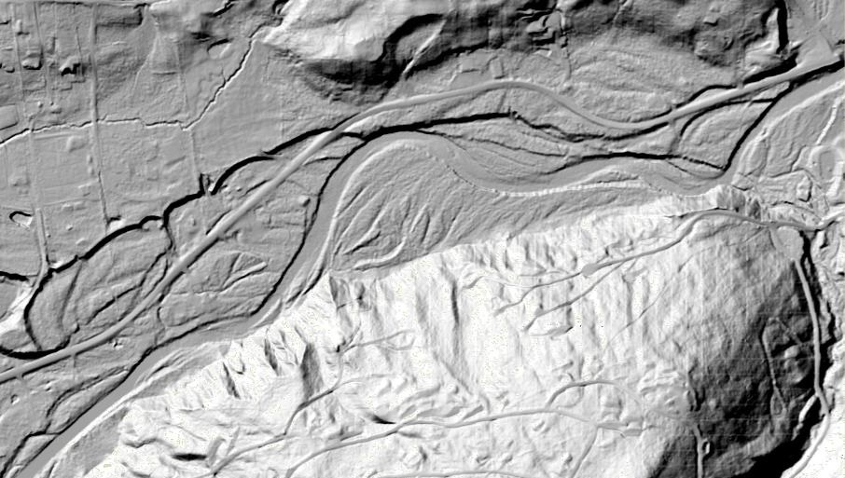
Planned Applications
Floodplain delineation

Slide 14
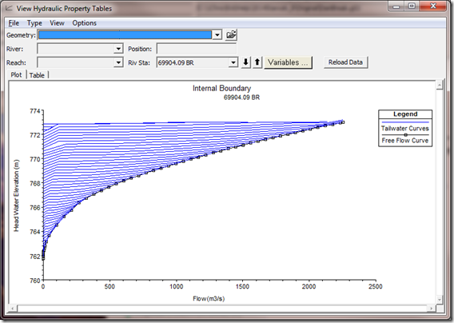
Planned Applications
Rating curve generation at new streamflow gaging stations
Credit: Christopher Goodell, WEST Consultants

Slide 15
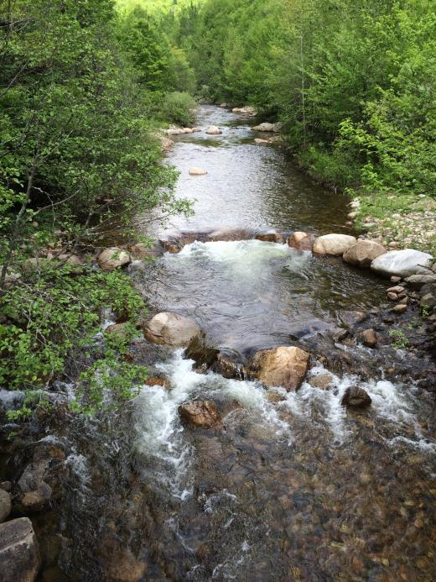
Planned Applications
Identifying straightened stream reaches
Photo: Nash Stream, Coos County, NH.
Credit: Trout Unlimited,
http://www.tu.org/tu-projects/nash-stream

Slide 16
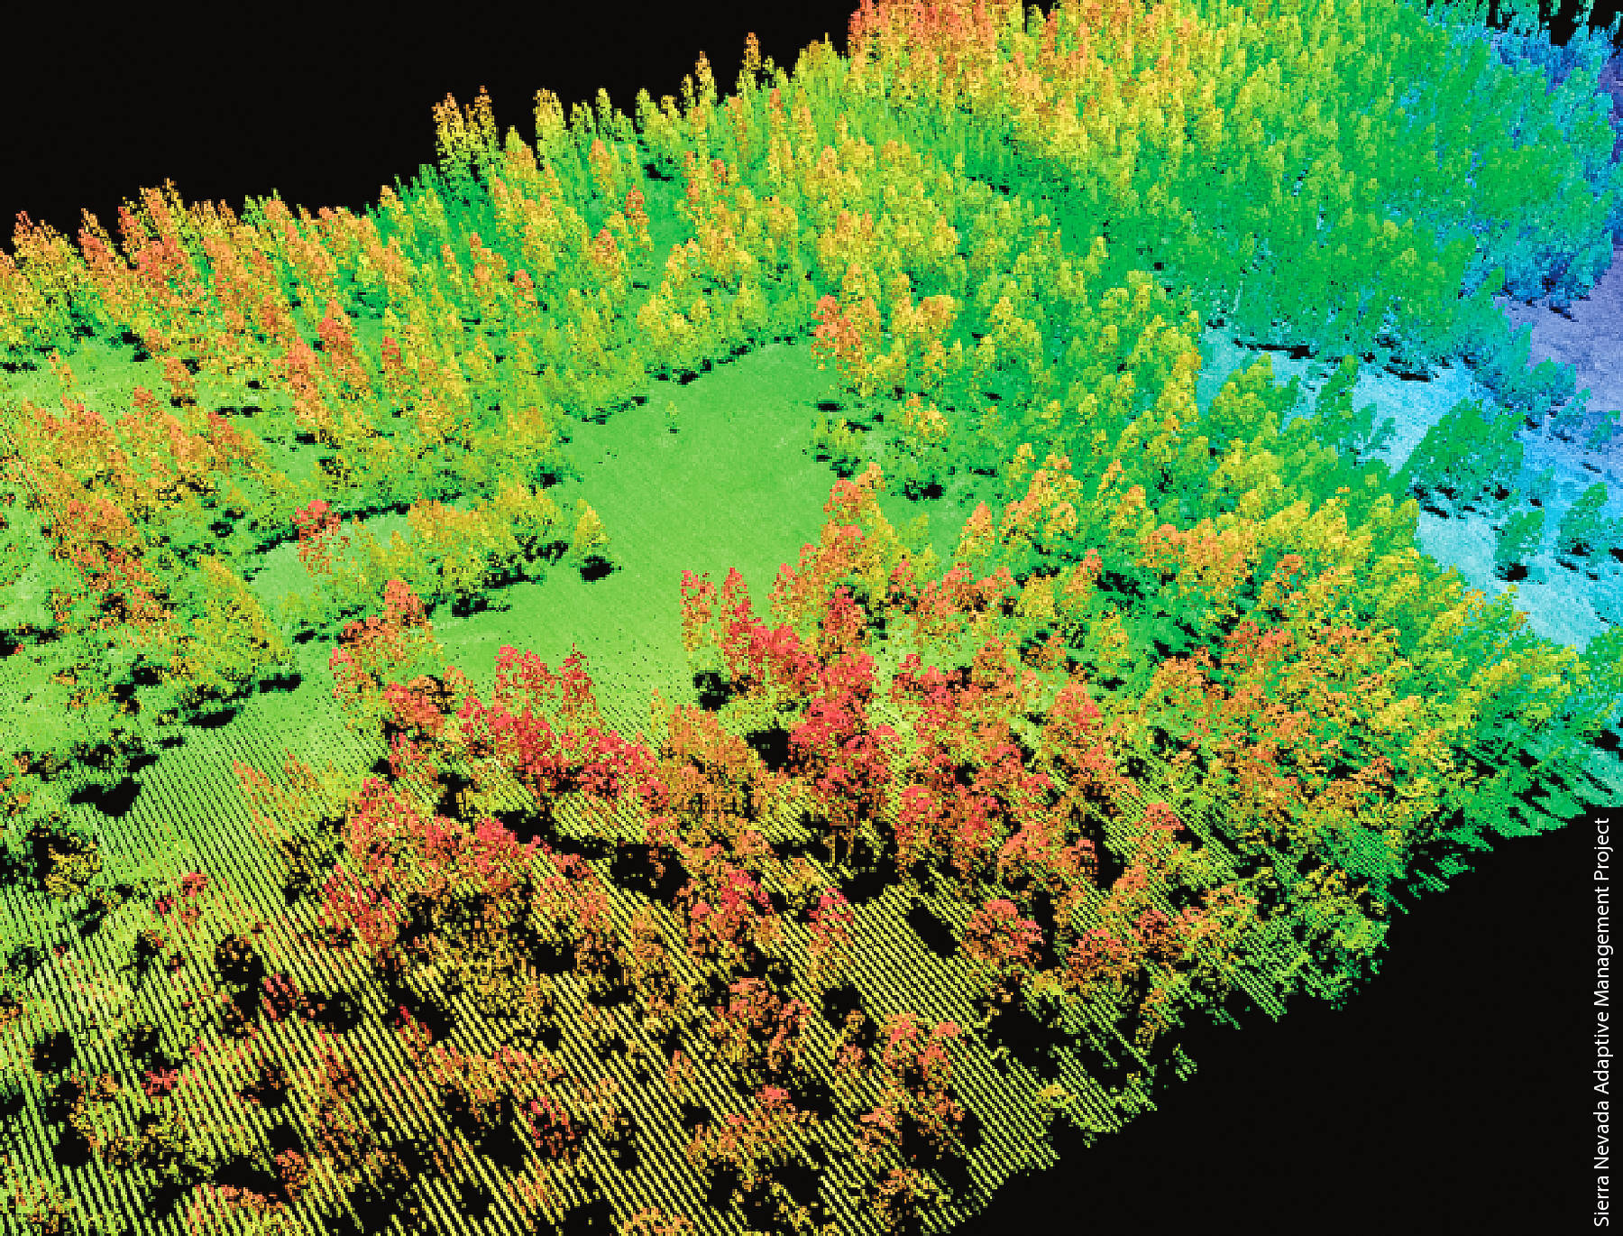
Future Applications
Advanced vegetation analysis
Pair with multi- and/or hyper-spectral imagery to map to species
Quantify landscape changes over time
Disturbance mapping
???
Kelly M, Di Tommaso S. 2015. Mapping forests with Lidar
provides flexible, accurate data with many uses.
Calif Agr 69(1):14-20. DOI: 10.3733/ca.v069n01p14

Slide 17
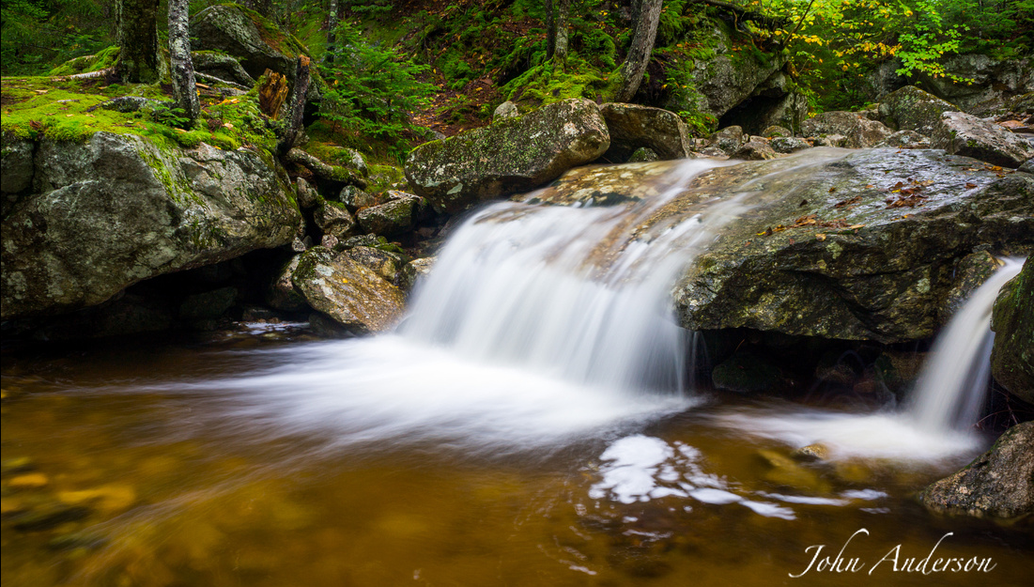
Questions?
Photo credit: John Anderson, 2015 WMNF Artist-in-Residence Program

